Slide 1
Valuing Stock Options:
The Black-Scholes-Merton Model
Chapter 13

Slide 2
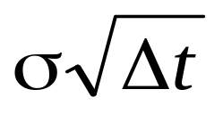
The Black-Scholes-Merton Random Walk Assumption
Consider a stock whose price is S
In a short period of time of length Δt the return on the stock (ΔS/S) is assumed to be normal with mean μΔt and standard deviation
μ is expected return and σ is volatility

Slide 3
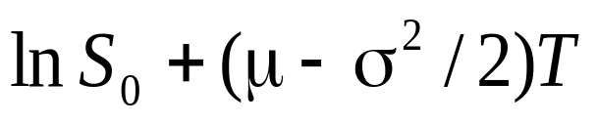
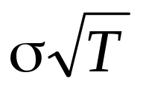
The Lognormal Property
These assumptions imply ln S_{T} is normally distributed with mean:
and standard deviation:
Because the logarithm of S_{T} is normal, S_{T} is lognormally distributed

Slide 4
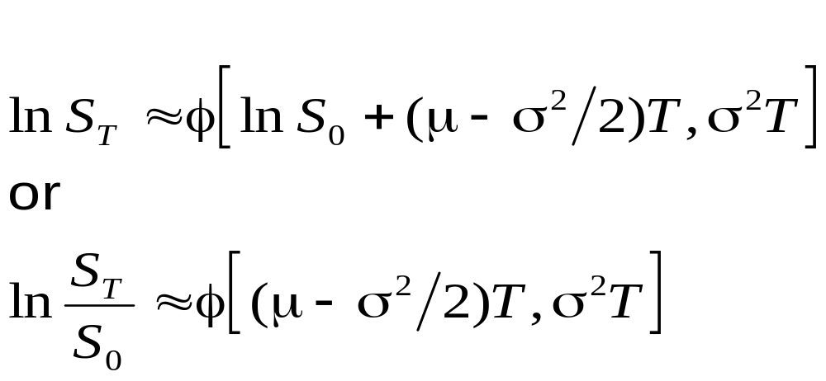
The Lognormal Property continued
where φ [m,v] is a normal distribution with mean m and variance v

Slide 5
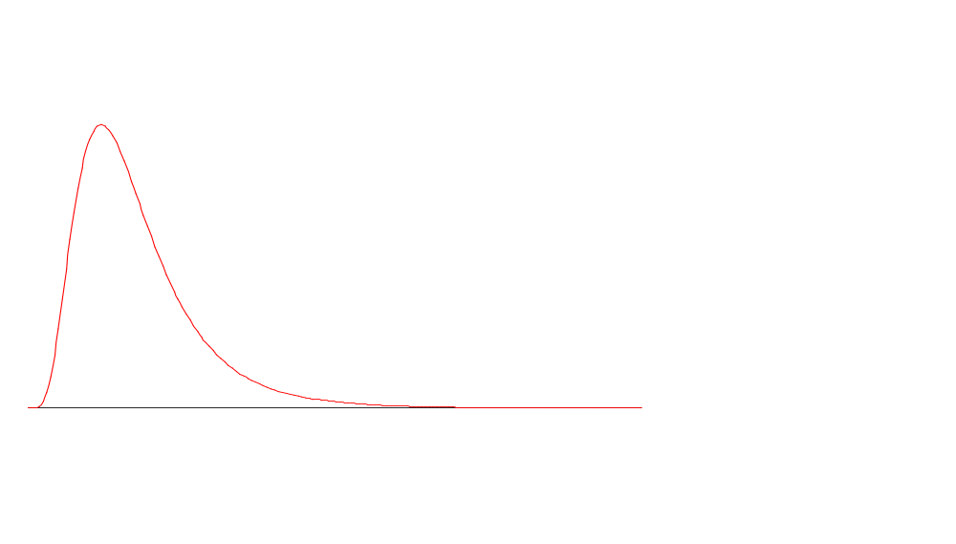
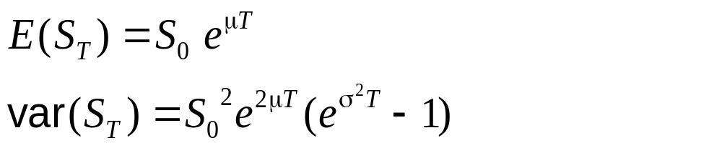
The Lognormal Distribution

Slide 6
The Expected Return
The expected value of the stock price at time T is S₀e^{μT}
The return in a short period Δt is μΔt
But the expected return on the stock with continuous compounding is μ – σ²/2
This reflects the difference between arithmetic and geometric means

Slide 7
Mutual Fund Returns (See Business Snapshot 13.1 on page 298)
Suppose that returns in successive years are 15%, 20%, 30%, -20% and 25%
The arithmetic mean of the returns is 14%
The returned that would actually be earned over the five years (the geometric mean) is 12.4%
The difference between 14% and 12.4% is analogous to the difference between μ and μ−σ²/2

Slide 8
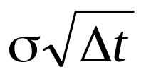
The Volatility
The volatility of an asset is the standard deviation of its continuously compounded rate of return in 1 year
The standard deviation of the return in time Δt is
If a stock price is $50 and its volatility is 25% per year what is the standard deviation of the price change in one day?

Slide 9
Nature of Volatility
Volatility is usually much greater when the market is open (i.e. the asset is trading) than when it is closed
For this reason time is usually measured in “trading days” not calendar days when options are valued
It is usually assumed that there are 252 trading days in a year

Slide 10
Example
Suppose it is April 1 and an option lasts to April 30 so that the number of days remaining is 30 calendar days or 22 trading days
The time to maturity would be assumed to be 22/252 = 0.0873 years

Slide 11
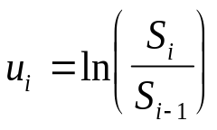
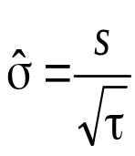
Estimating Volatility from Historical Data (page 299-301)
Take observations S₀, S₁, . . . , S_{n} at intervals of τ years (e.g. for weekly data τ = 1/52)
Calculate the continuously compounded return in each interval as:
Calculate the standard deviation, s , of the u_{i}´s
The historical volatility estimate is:

Slide 12
The Concepts Underlying Black-Scholes
The option price and the stock price depend on the same underlying source of uncertainty
We can form a portfolio consisting of the stock and the option which eliminates this source of uncertainty
The portfolio is instantaneously riskless and must instantaneously earn the risk-free rate

Slide 13
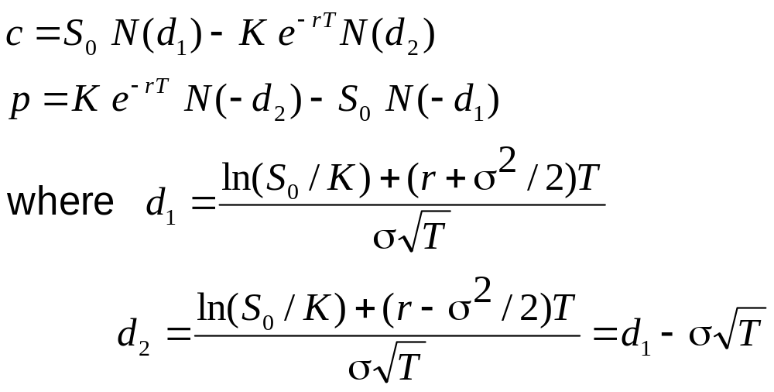
The Black-Scholes Formulas
(See page 304)

Slide 14
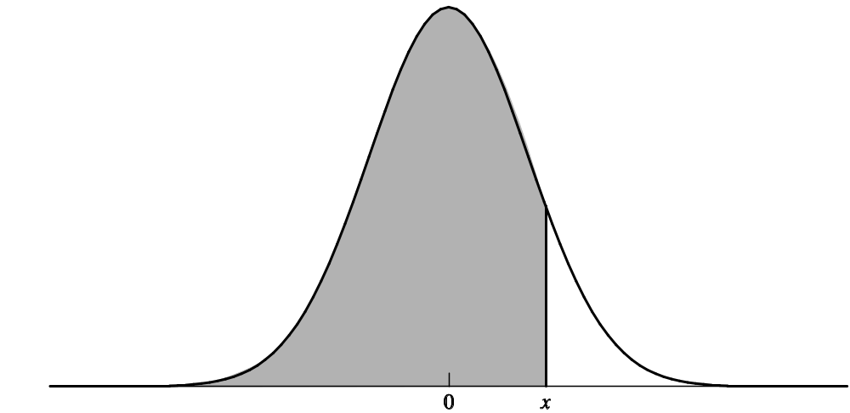
The N(x) Function
N(x) is the probability that a normally distributed variable with a mean of zero and a standard deviation of 1 is less than x
See tables at the end of the book

Slide 15
Properties of Black-Scholes Formula
As S₀ becomes very large c tends to S₀ – Ke^{-rT} and p tends to zero
As S₀ becomes very small c tends to zero and p tends to Ke^{-rT} – S₀
What happens as σ becomes very large?
What happens as T becomes very large?

Slide 16
Risk-Neutral Valuation
The variable μ does not appear in the Black-Scholes equation
The equation is independent of all variables affected by risk preference
This is consistent with the risk-neutral valuation principle

Slide 17
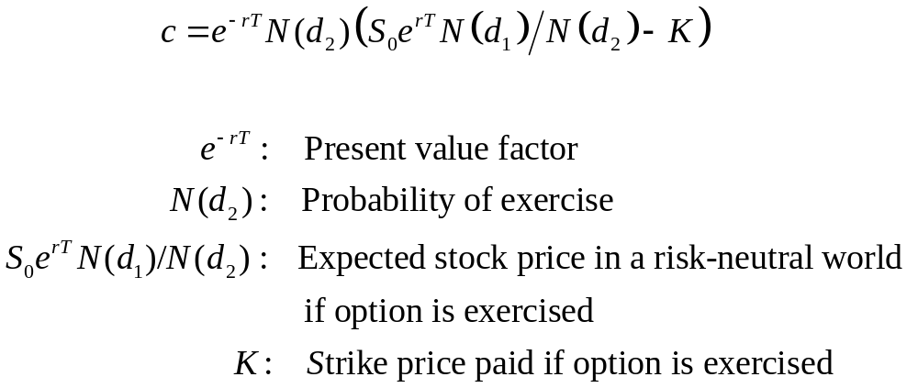
Understanding Black-Scholes

Slide 18
Applying Risk-Neutral Valuation
Assume that the expected return from an asset is the risk-free rate
Calculate the expected payoff from the derivative
Discount at the risk-free rate

Slide 19
Valuing a Forward Contract with Risk-Neutral Valuation
Payoff is S_{T} – K
Expected payoff in a risk-neutral world is S₀e^{rT} – K
Present value of expected payoff is
e^{-rT}[S₀e^{rT} – K]=S₀ – Ke^{-rT}

Slide 20
Implied Volatility
The implied volatility of an option is the volatility for which the Black-Scholes price equals the market price
The is a one-to-one correspondence between prices and implied volatilities
Traders and brokers often quote implied volatilities rather than dollar prices

Slide 21
The VIX Index: S&P 500 Implied Volatility from Jan. 2004 to July 2015

Slide 22
Dividends
European options on dividend-paying stocks are valued by substituting the stock price less the present value of dividends into the Black-Scholes-Merton formula
Only dividends with ex-dividend dates during life of option should be included
The “dividend” should be the expected reduction in the stock price on the ex-dividend date

Slide 23
American Calls
An American call on a non-dividend-paying stock should never be exercised early
An American call on a dividend-paying stock should only ever be exercised immediately prior to an ex-dividend date

Slide 24
Black’s Approximation for Dealing with
Dividends in American Call Options
Set the American price equal to the maximum of two European prices:
The 1st European price is for an option maturing at the same time as the American option
The 2nd European price is for an option maturing just before the final ex-dividend date

